Slide 1


Slide 2

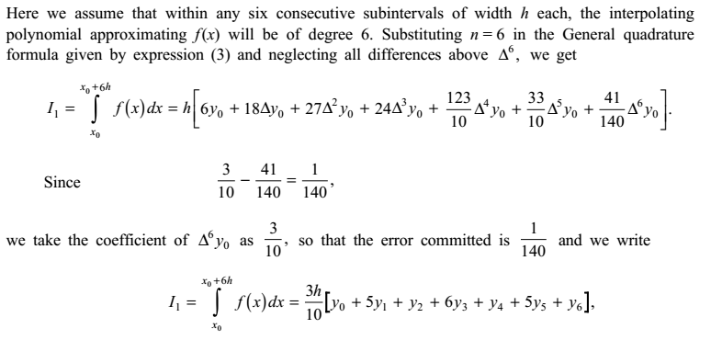

Numerical Methods
National University of Science and Technology, Islamabad

Slide 3
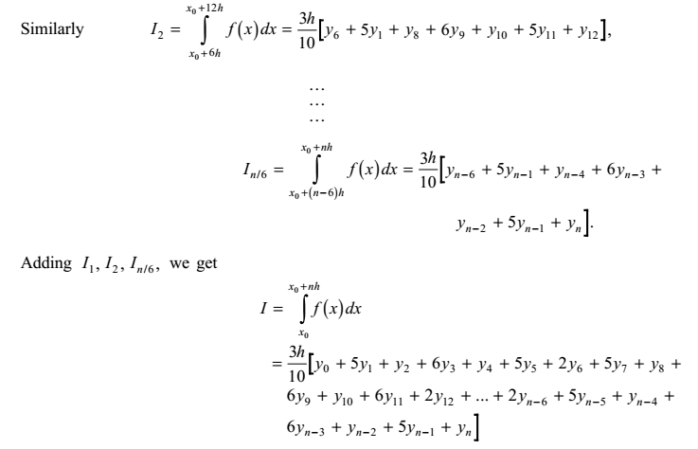
Numerical Methods
National University of Science and Technology, Islamabad

Slide 4
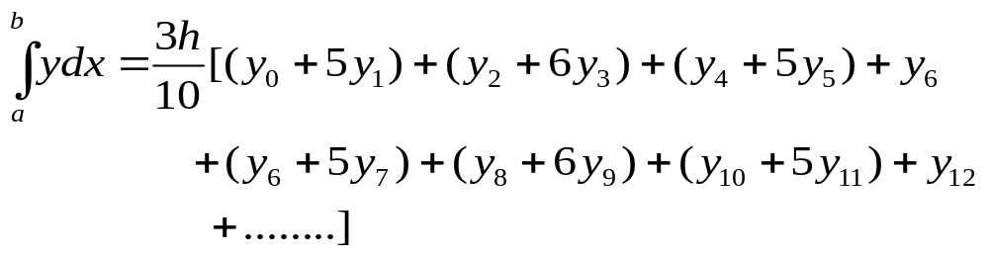
Numerical Methods
How to remember Weddle’s rule
Numerical Integration
National University of Science and Technology, Islamabad

Slide 5
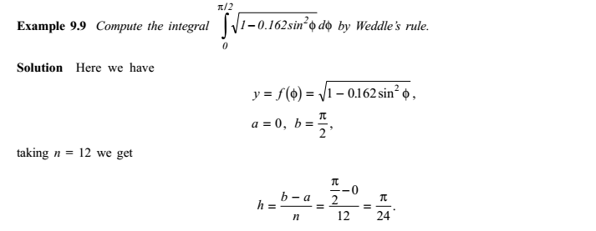
Numerical Methods
National University of Science and Technology, Islamabad

Slide 6
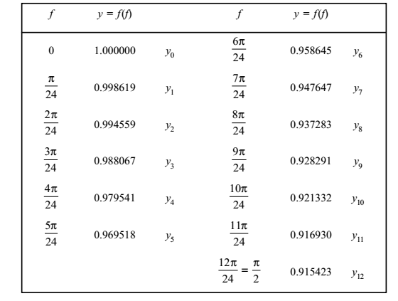
Numerical Methods
National University of Science and Technology, Islamabad

Slide 7
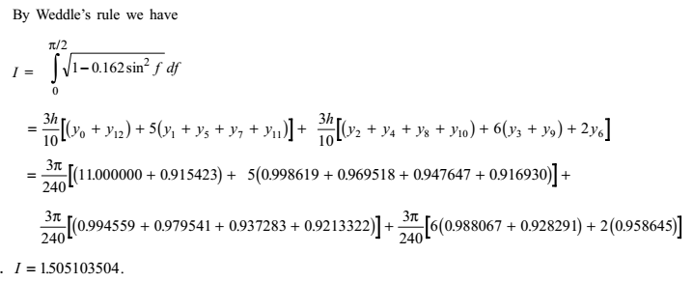
Numerical Methods
National University of Science and Technology, Islamabad

Slide 8
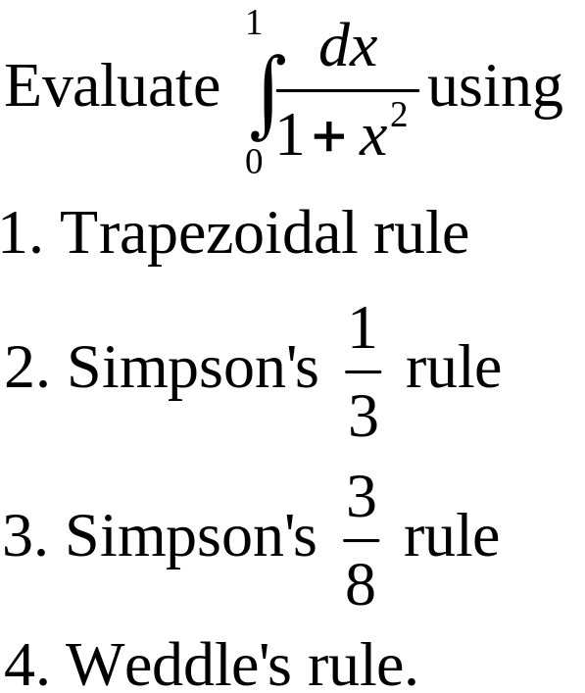
Numerical Methods
Class Task
National University of Science and Technology, Islamabad

Slide 9
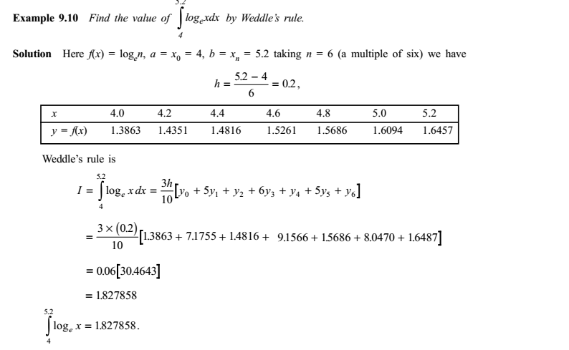
Numerical Methods
National University of Science and Technology, Islamabad

Slide 10
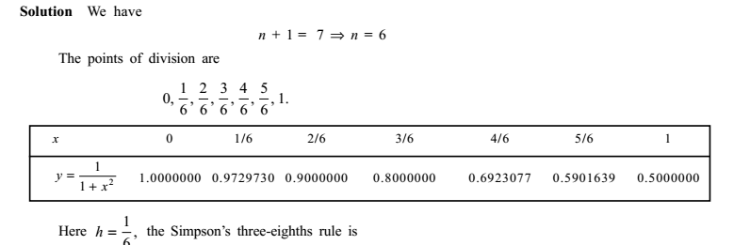
Numerical Methods
National University of Science and Technology, Islamabad

Slide 11
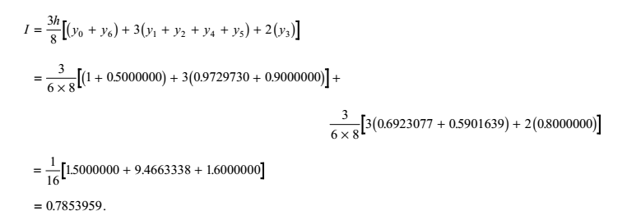
Numerical Methods
National University of Science and Technology, Islamabad

Slide 12
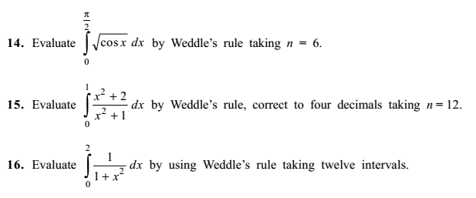
Numerical Methods
National University of Science and Technology, Islamabad

Slide 13


Numerical Methods
National University of Science and Technology, Islamabad

